Slide 1
About Me
Ritesh Singh
Sun Certified java Professional
Oracle Certified Database Administrator
Certified Ethical Hacker
Certified EC-Council Instructor (CEI)

Slide 2
MySQL CREATE DATABASE
MySQL implements a database as a directory that contains all files which correspond to tables in the database.
To create a new database in MySQL, you use the CREATE DATABASE statement with the following syntax:
CREATE DATABASE [IF NOT EXISTS] database_name
[CHARACTER SET charset_name]
[COLLATE collation_name]
First, specify the database_name following the CREATE DATABASE clause. The database name must be unique within the MySQL server instance. If you try to create a database with a name that already exists, MySQL issues an error.

Slide 3
Second, to avoid an error in case you accidentally create a database that already exists, you can specify the IF NOT EXISTS option. In this case, MySQL does not issue an error but terminates the CREATE DATABASE statement instead.
Third, specify the character set and collation for the new database at creation time. If you omit the CHARACTER SET and COLLATE clauses, MySQL uses the default character set and collation for the new database.

Slide 4
Creating a new database using mysql program
To create a new database via the mysql program, you use the following steps:
First, log in to the MySQL Server using the root user
>mysql -u root -p
Enter password: ********
Type the password for the root user and press Enter.
Next, to display the existing database in the server to make sure that you are not creating a new database that already exists, you use the SHOW DATABASES command as follows:

Slide 5
mysql> SHOW DATABASES;
+--------------------+
| Database |
+--------------------+
| classicmodels |
| information_schema |
| mysql |
| performance_schema |
| sys |
+--------------------+
5 rows in set (0.00 sec)
MySQL returns five existing databases in the current server.

Slide 6
Then, issue the CREATE DATABASE command with the database e.g., testdb and press Enter:
mysql> CREATE DATABASE testdb;
Query OK, 1 row affected (0.12 sec)
After that, if you want to review the created database, you can use the SHOW CREATE DATABASE command:
mysql> SHOW CREATE DATABASE testdb;

Slide 7
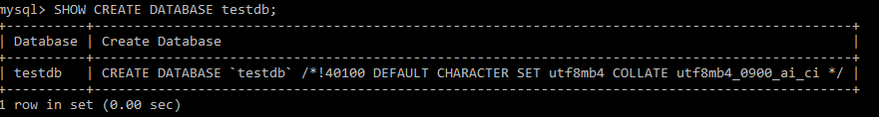

Slide 8
MySQL returns the database name and the character set and collation of the database.
Finally, to access the newly created database, you use the USE database command as follows:
mysql> USE testdb;
Database changed
Now, you can start creating tables and other databases objects within the testdb database.
To quit the mysql program, type exit command:
mysql> exit
Bye

Slide 9
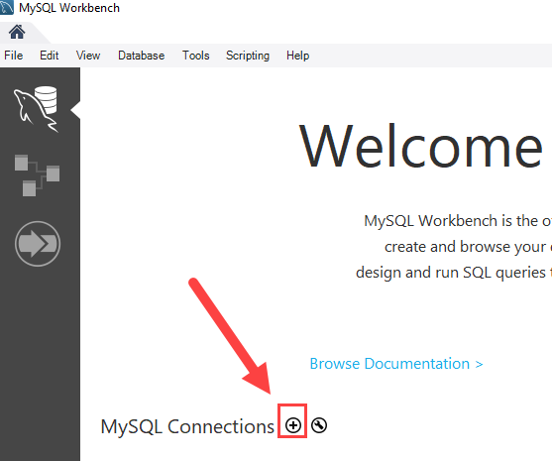
Creating a new database using MySQL Workbench
To create a new database using the MySQL Workbench, you follow these steps:
First, launch the MySQL Workbench and click the setup new connection button as shown in the following screenshot:

Slide 10
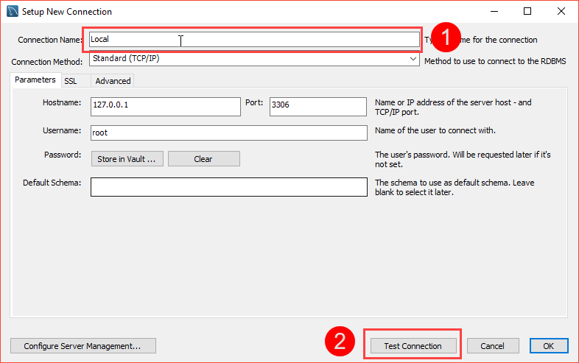
Second, type the name for the connection and click the Test Connection button.

Slide 11
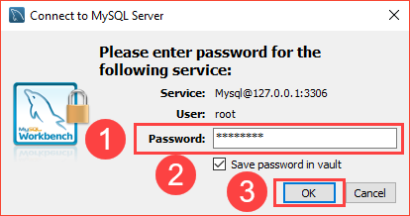
MySQL Workbench displays a dialog asking for the password of the root user:

Slide 12
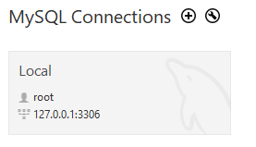
You need to (1) type the password for the root user, (2) check the Save password in vault, and (3) click OK button.
Third, double-click the connection name Local to connect to the MySQL Server.

Slide 13
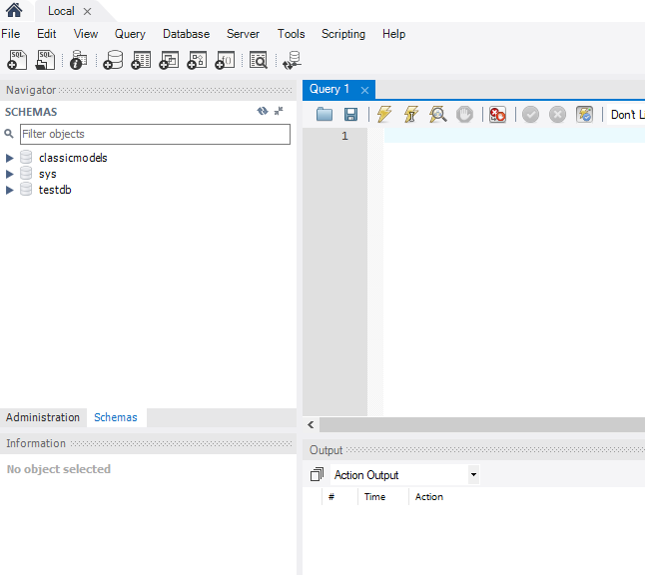
MySQL Workbench opens the following window which consists of four parts: Navigator, Query, Information, and Output.

Slide 14
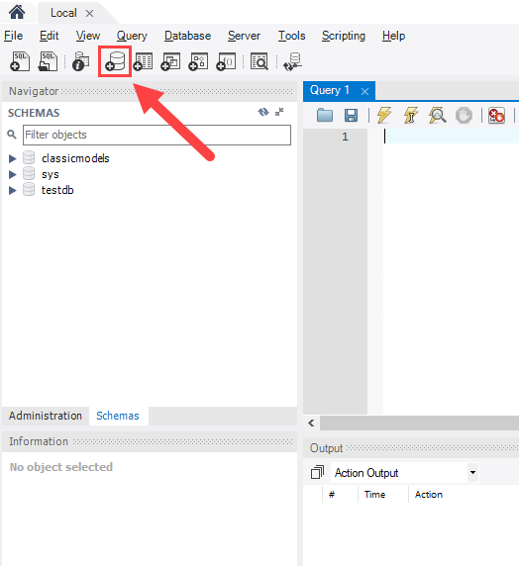
Fourth, click the create a new schema in the connected server button from the toolbar:

Slide 15
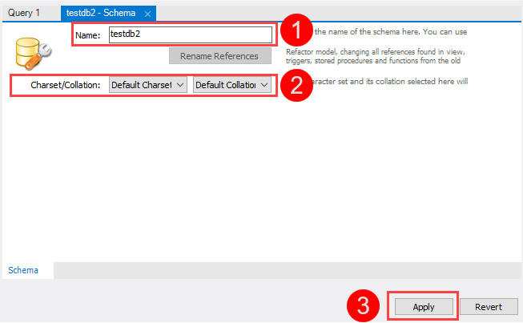
In MySQL, the schema is the synonym for the database. Creating a new schema also means creating a new database.
Fifth, the following window is open. You need to (1) enter the schema name, (2) change the character set and collation if necessary, and click the Apply button:

Slide 16
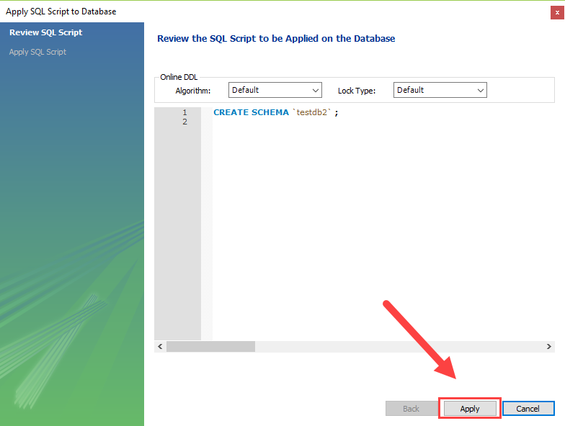
Sixth, MySQL Workbench opens the following window that displays the SQL script which will be executed. Note that the CREATE SCHEMA statement command has the same effect as the CREATE DATABASE statement.

Slide 17
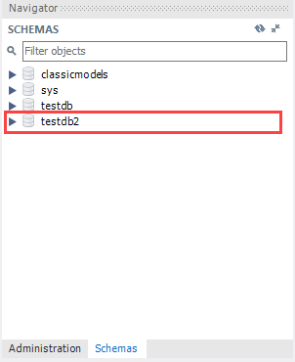
If everything is fine, you will see the new database created and showed in the schemas tab of the Navigator section.

Slide 18
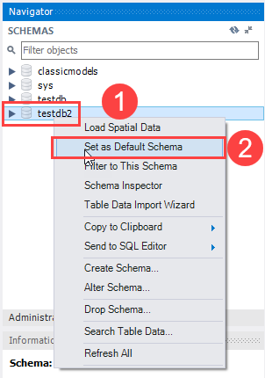
Seventh, to select the testdb2 database, (1) right click the database name and (2) choose Set as Default Schema menu item:

Slide 19
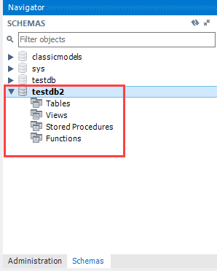
The testdb2 node is open as shown in the following screenshot.

